Slide 1
Materials: https://www.dropbox.com/scl/fo/qj348wke4gla16gka7wyw/AL6sQWFd_P5MLFfe1HHsfk4?rlkey=5su9g79eg7r5uiuxzo97n56a1&dl=0

Slide 2
Fundamental written discovery

Slide 3
AGENDA
Introduction: Me and My CR 26
Interrogatories: CR 33, First Salvo: ER 802(d)(2)
Requests for Production: CR 34, Give me Stuff
Requests for Admissions: CR 36, Give me Obvious
Deposition (briefly) – Sonja Hardenbrook
ER 904: Admit Authentication
Miscellaneous? CR 35? CR 27? CR 31?

Slide 4
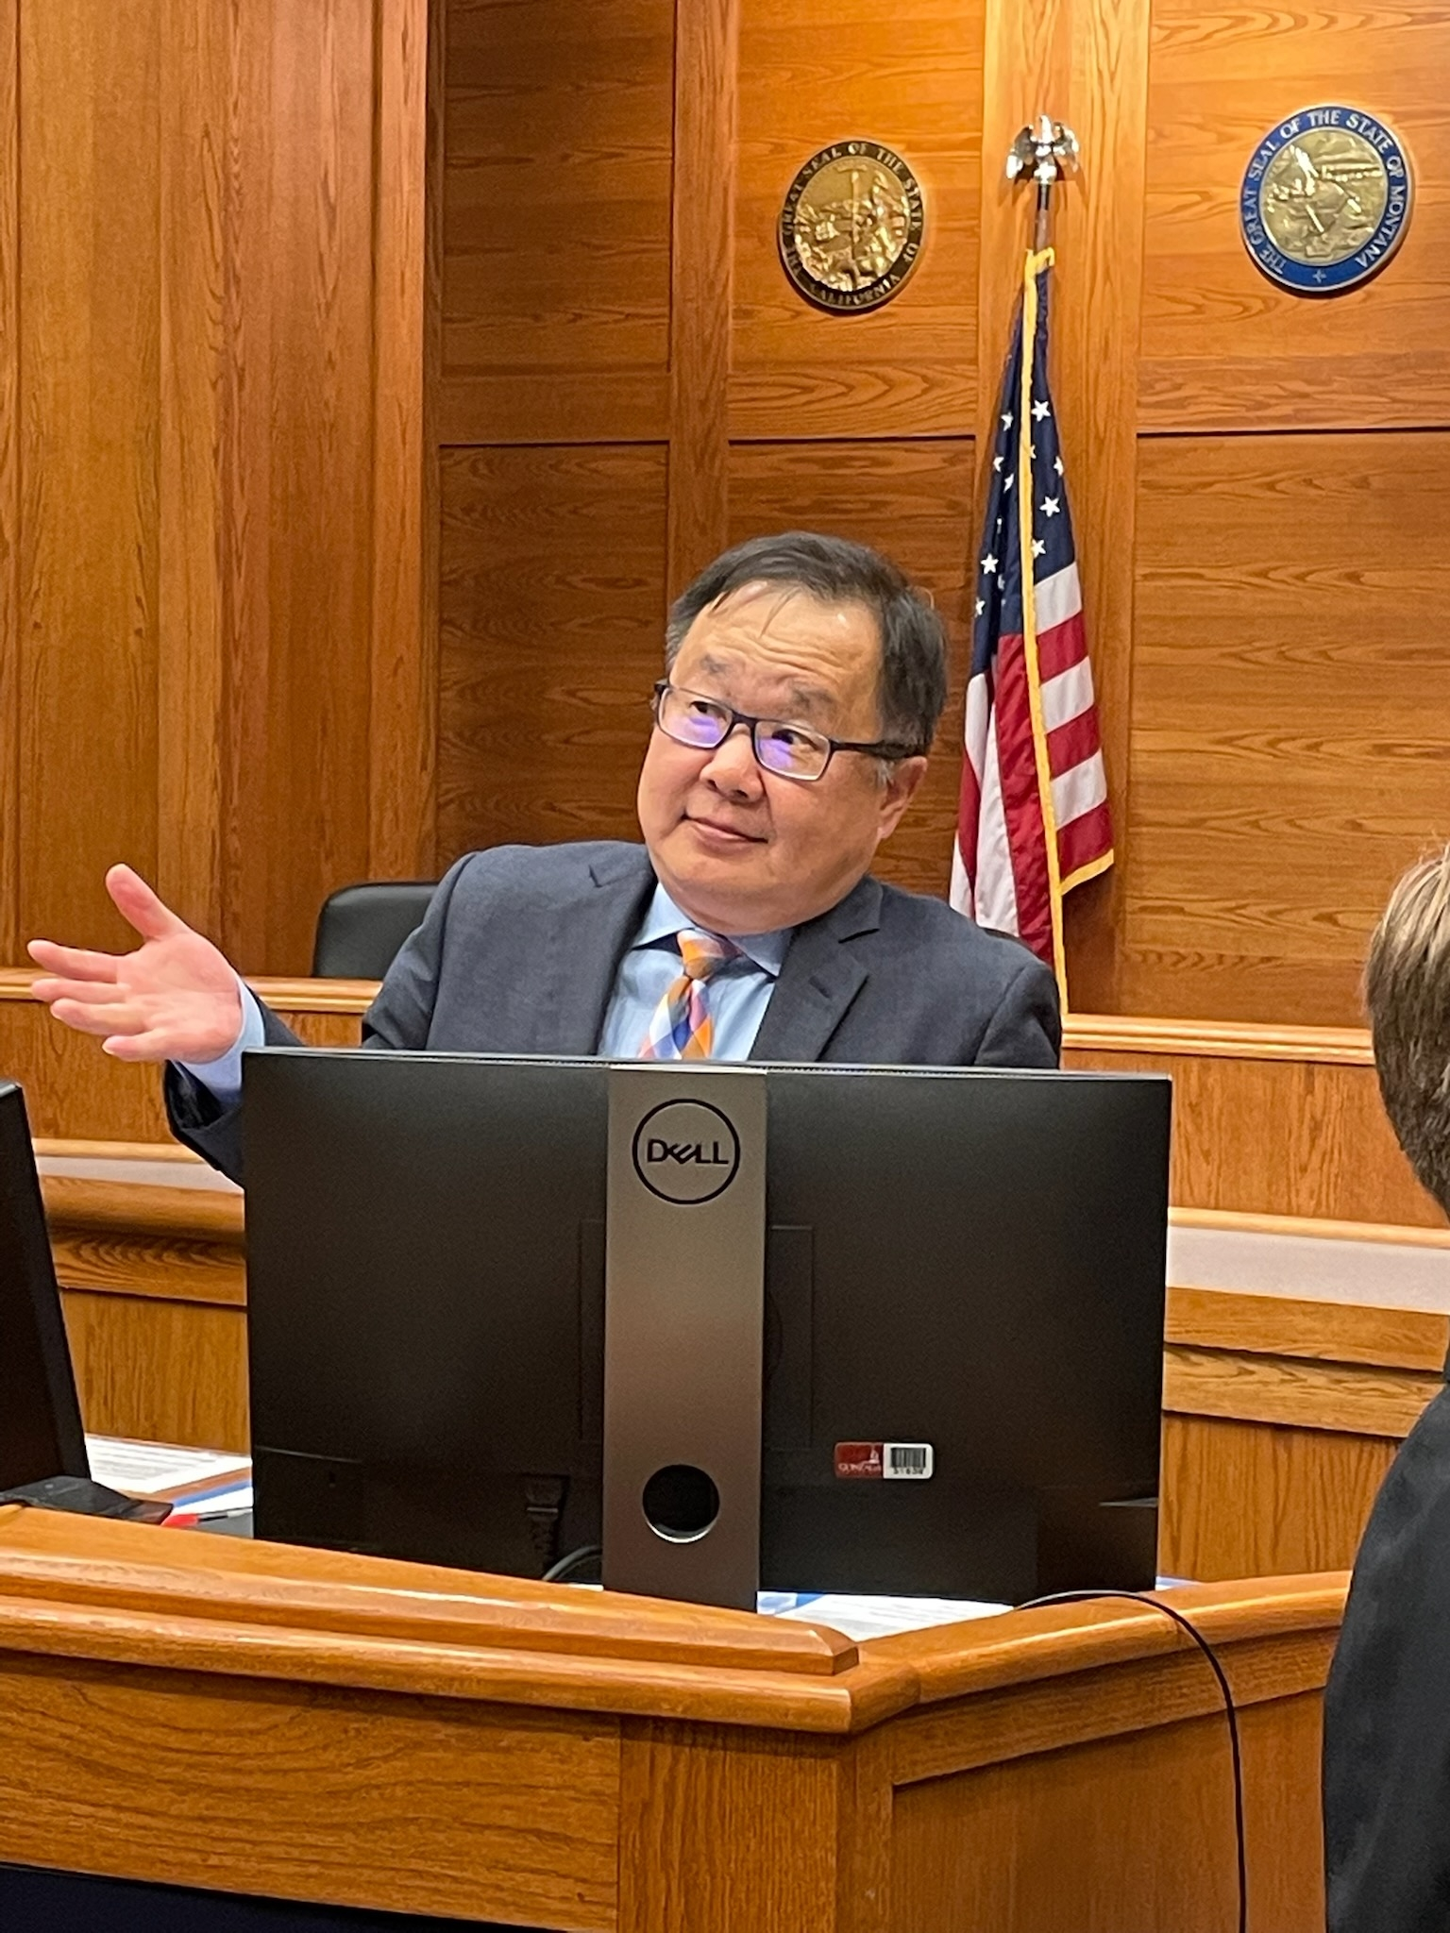
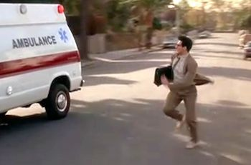
Introduction ken Chang www.hjmc-law.com kchang@hjmc-law.com

Slide 5
Civil Discovery cr 26

Slide 6
Poll
I hate civil rules. I am a criminal defense attorney. I don’t know civil rules and I don’t want to know civil rules, and I am only here because I need the credit.
I’ve done some depositions, and I’ve done very limited civil discovery, but not comfortable enough to send written requests and hate having to respond to written civil discovery requests.
I am comfortable with drafting and responding to written civil discovery, and routinely use them, but I have some questions you may or may be able to answer.
I am very familiar with civil discovery, and in fact I can teach this CLE, but I am only here because I need the credit.

Slide 7
The most important point I will make

Slide 8
https://www.courts.wa.gov/court_rules/?fa=court_rules.list&group=sup&set=CR

Slide 9
https://www.courts.wa.gov/court_rules/?fa=court_rules.localsupbycrt
Local

Slide 10
Cr 26 Bird’s eye view
(b)(1) SCOPE and LIMIT
“the information sought appears reasonably calculated to lead to the discovery of admissible evidence.”
Limited by Court
(b)(4) Work Product Rule
(b)(5) Facts AND Opinions held by experts …. acquired or developed in anticipation of litigation or for trial
(c) Protective order
(e) Supplementation of Responses

Slide 11
Civil discovery scope
The standard of relevance for purposes of discovery is much broader than the standard required under the evidence rules for admissibility at trial. 4 J. Moore & J. Lucas, Federal Practice ¶ 26.56[4], at 26–170 (2d ed. 1983).
The fact that the evidence sought “would otherwise be inadmissible at trial is not an impediment to discovery”, 4 L. Orland, Wash.Prac., Rules Practice § 5305, at 22 (3d ed. 1983), so long as “the information sought appears reasonably calculated to lead to the discovery of admissible evidence.” CR 26(b)(1).
[A]lthough certain information may not be used as proof at the trial, still, information obtained by discovery may aid a party in preparing his case, in anticipating his opponents' position, and in gathering further evidence.
J. Moore & J. Lucas, supra.
Barfield v. City of Seattle, 100 Wash. 2d 878, 886, 676 P.2d 438, 442–43 (1984)
MUCH BROADER than admissibility
“reasonably calculated to lead to the discovery of admissible evidence”
“Relevant to the subject matter”
Not relevant in terms of ER 401.
BUT relevant to the SUBJECT MATTER.

Slide 12
Civil discovery scope
To begin, the Washington Supreme Court “has consistently expressed displeasure with random and suspicionless searches, reasoning that they amount to nothing more than an impermissible fishing expedition.” Jorden, 160 Wash.2d at 127, 156 P.3d 893. For example, random urinalysis screens of probationers are permissible to monitor compliance with probation conditions, but cannot be used as “ ‘a fishing expedition to discover evidence of other crimes, past or present.’”
State v. Hartman, 27 Wash. App. 2d 952, 974, 534 P.3d 423, 435 (2023), review denied, 540 P.3d 778 (Wash. 2024)
STAY IN YOUR OWN POND/SUBJECT MATTER

Slide 13
Civil Discovery - Limit
Only Court can limit discovery (Local Rules and/or Protective order)
Unreasonably cumulative or duplicative, or is obtainable from some other source that is more convenient, less burdensome, or less expensive;
Had ample opportunity by discovery in the action to obtain the information sought (additional discovery);
Unduly burdensome or expensive – balanced by “the needs of the case, the amount in controversy, limitations on the parties, resources, and the importance of the issues at stake.”

Slide 14
Work Product Rule (codified): CR26(b)(4)
Trial Preparation: Materials –
documents and tangible things – prepared in anticipation of litigation or for trial by OR FOR another party’s representatives
Attorney, consultant, surety, indemnitor, insurer or agent
Discoverable ONLY by showing
Substantial need, AND
Inability to obtain the substantial equivalent by other means.
Mental impressions, conclusions, opinions or legal theories of any attorney or other representative of a party concerning litigation (absolute)

Slide 15
Work Product Rule (codified): CR26(b)(4)
Hickman v. Taylor, 329 U.S. 495, 67 S.Ct. 385, 91 L.Ed. 451 (1947)
Upjohn Co. v. United States, 449 U.S. 383, 101 S.Ct. 677, 66 L.Ed.2d 584 (1981)
Kittitas Cnty. v. Allphin, 190 Wash. 2d 691, 704, 416 P.3d 1232, 1239–40 (2018), as amended (June 18, 2018)
(1) The mental impressions of the attorney and other representatives of a party are absolutely protected, unless their mental impressions are directly at issue. Pappas v. Holloway, 114 Wn.2d 198, 212, 787 P.2d 30 (1990).
(2) The notes or memoranda prepared by the attorney from oral communications should be absolutely protected, unless the attorney's mental impressions are directly at issue. See Pappas, 114 Wn.2d at 212 [787 P.2d 30]; Dever v. Fowler, 63 Wn. App. 35, 48, 816 P.2d 1237 (1991).
(3) The factual written statements and other tangible items gathered by the attorney and other representatives of a party are subject to disclosure only upon a showing that the party seeking disclosure of the documents actually has substantial need of the materials and that the party is unable, without undue hardship, to obtain the substantial equivalent of the materials by other means, Mental impressions of the attorney and other representatives embedded in factual statements should be redacted. Heidebrink, 104 Wn.2d 392 [706 P.2d 212].

Slide 16
Work Product Rule (codified): CR26(b)(4): WAIVER!
Kittitas Cnty. v. Allphin, 190 Wash. 2d 691, 708, 416 P.3d 1232, 1239–40 (2018), as amended (June 18, 2018)
We now adopt the rule that a party waives its work product protection when it discloses work product documents to a third party in a manner creating a significant likelihood that an adversary will obtain the information
Giving it to your consulting expert?
Giving it to your investigator?
Giving it to your consulting expert AND then endorsing that expert?
Giving it to your witness?
Sharing it with Co-party? Allphin (What is a coparty? “similarly aligned on a matter of common interest”)

Slide 17
CR 26(b)(5) Expert
Not all Experts are the Same – Facts Known and Opinions held by experts that were ACQUIRED OR DEVELOPED IN ANTICIPATION of litigation or trial.
Interrogatory – identity of expected trial experts, subject matter, substance of the facts and opinions, and summary of grounds for each opinions, and other information about experts as may be discoverable. (A)(i)
Depositions (A)(ii)
Consulting expert – CR 35 exam, or “exceptional circumstances under which it is impracticable for the party seeking discovery to obtain facts or opinions on the same subject by other means.” (B)
Pay them if you made them work – “a fair portion of the fees and expenses reasonably incurred by [the other] party in obtaining facts and opinions from the expert. (C)

Slide 18
Protective order: CR 26(c)
Motion by a party OR the person from whom discovery is sought
“Justice” requires to protect from annoyance, embarrassment, oppression, or undue burden or expense.
Can’t have that discovery
Specified terms and conditions
Specific METHOD of discovery
Limited topics/subject matter
Who can be present
Disclosure of discovery
Trade Secrets, and other $$
Do it at the same time
CR 37(a)(4) – SANCTIONS: See my other session

Slide 19
Supplemental response: CR 26(e)
No Duty to Supplement the Response, UNLESS
Duty seasonably to supplement
Identity or location of persons having knowledge of discoverable matters,
Identity of expert witnesses (all experts), subject matter and substance
Knows the response was incorrect when made, or
Knows the response correct when made, but NO LONGER TRUE AND CIRCUMSTANCE SHOWS KNOWING CONCEALMENT.
NEW REQUEST for Supplementation!

Slide 20
Cr 33: INTERROGATORIES
WHY BOTHER?
Mechanics
Contention Interrogatories
Answering them (and OBJECTING to them)

Slide 21
Interrogatories: Why? Just WHY?
Usually the First Salvo of Discovery
Easy to do
Civil “Bill of Particulars
Can lead to further discovery and Development of Theories
LIMIT SURPRISES (remember to ask for supplementation)
Statement of Party Opponent: admissible for any purposes.
As An Exhibit to Deposition – CR 30(b)(6) or anyone.

Slide 22
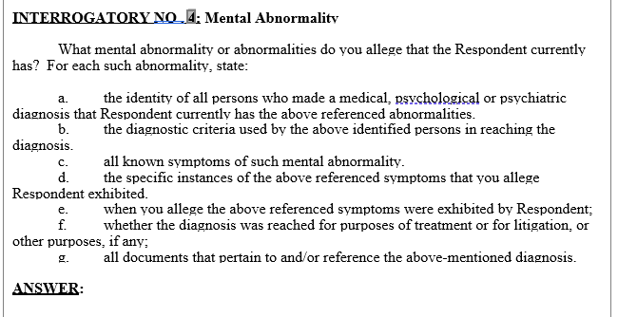
Interrogatories:

Slide 23
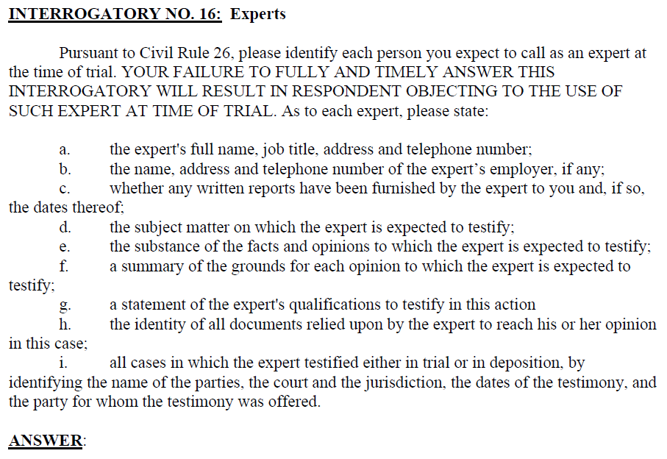
Interrogatories:

Slide 24
Interrogatories:

Slide 25
Interrogatories:

Slide 26
Contention interrogatories
CR 33(b): An interrogatory otherwise proper is not necessarily objectionable merely because an answer to the interrogatory involves an opinion or contention that relates to fact or the application of law to fact, but the court may order that such an interrogatory need not be answered until after designated discovery has been completed or until a pretrial conference or other later time.

Slide 27
Interrogatory: mechanics
Any Party to any other party, to be answered by the party
If party is a public or private corporation … or governmental agency, by any officer or agent, “such information as is AVAILBLE TO THE PARTY.”
CR 26(g): Ever request, response or objection, signed by a lawyer, constitutes a certification that
Consistent with existing rules or law or good faith argument for the extension, modification or reversal of existing law;
Not interposed for improper purpose, (harass or delay or increase cost)
Not unreasonable or unduly burdensome or expensive under the circumstances.
If made in violation, court “shall” impose an appropriate sanction.
WHAT INFORMATION YOU WANT/NEED FROM THE OPPOSING PARTY?
CHECK THE LOCAL RULES!
ASK to SUPPLEMENT – Enforcing Discovery

Slide 28
Answering Interrogatories
Got 30 days
Client Letter (Sample)
Client Answers. You Object. (Objection Sample)
Object before 30 days even without answering.
It is well established that a failure to object to discovery requests within the time required constitutes a waiver of any objection. Davis v. Fendler, 650 F.2d 1154, 1160 (9th Cir.1981)
Richmark Corp. v. Timber Falling Consultants, 959 F.2d 1468, 1473 (9th Cir. 1992)

Slide 29
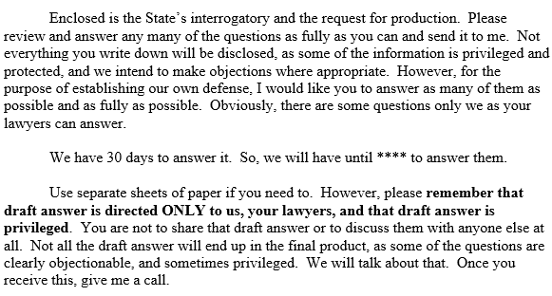
Sample letter to client

Slide 30
Objections (serve them even if not ready to serve the actual responses within 30days)
INTERROGATORY NO. 1: [Set out interrogatory]
ANSWER:
OBJECTION: [Set out objection]
INTERROGATORY NO. 2:
ANSWER:
OBJECTION: Objection is made to section (a) of interrogatory no. 2 because [set out grounds, e.g., it seeks information for a time period which is five years prior to the events at issue in the action and is not reasonably calculated to lead to the discovery of relevant or admissible information in the action.]
Without waiving the above objection, [responding party] answers the remaining sections of the interrogatory as follows: [set out answer to sections or parts of interrogatory to which no objection is being made.]

Slide 31
Objections (be judicious)
SAMPLE OBJECTIONS
My List of objections I’ve used, and added as time went.
No Warranties made. Possibly outdated.
14 Wash. Prac., Civil Procedures § 15:9
Has a list of proper objections
Also included
§ 15:10 has list of improper objections.

Slide 32
Answering Interrogatories
Client’s Chance to Tell his/her/their side of the story
Will it be reviewed by experts?
Will it be used against your client at depo? Sure, but it’s a trap that can be avoided.
NOT “ADMISSION” as in CR 36, but admission as in ER 801(d)(2).
CR 33(c): Option to Produce Business Records.
business records of the answering party
Burden of ascertaining the answer substantially the same.
Sufficiently specific

Slide 33
Answering Interrogatories
Don’t be Afraid
Supplement
Amend
If your client doesn’t remember, the right answer is “I don’t remember” AFTER “reasonable inquiry.”
“The responses must be consistent with the letter, spirit and purpose of the rules.”
Washington State Physicians Ins. Exch. & Ass'n v. Fisons Corp., 122 Wash. 2d 299, 344, 858 P.2d 1054, 1078 (1993)
Important case- Enforcement of Discovery

Slide 34
Cr 34: RFP
DO YOU TAKE IT ON FAITH THAT THE OTHER SIDE GAVE YOU ALL THE RELEVANT DOCUMENTS? If yes, skip. If no, continue.
Truly Information Gathering Tool
Mechanics. This is NOT CR 45.
Responding: “Privilege Log” It’s a thing.

Slide 35
RFP
Do you trust your opposing counsel?
Of course you do.
But what if they “accidentally” left out some key piece of information?
If you DIDN’T ask for it, do you have a remedy?
Disclosure of Exhibits should not be the first time you see any documents or recordings
Is it malpractice NOT to serve RFP in a civil case?
Why am I asking these questions?

Slide 36
RFP: Mechanics
You can combine with Interrogatories, but you don’t have to.
You don’t FILE the discovery requests. Can serve anytime (before discovery cutoff)
Electronic Discovery: CR 34(b)(3)(F) – Does this matter to us?
CR 34(b)(c): This is only for a party to a litigation. Non-parties must be served with a subpoena duces tecum under CR 45 – service of process
CHECK THE LOCAL RULES!

Slide 37
RFP: Examples

Slide 38
RFP: responding
You got 30 days
Things that are in possession, custody or control of your client or you.
“Don’t give it to me because that way we won’t have to produce it to the other side.” – Nope.
“Give it to me because it will then be a protected work product.” – Nope. In re Det. of Williams, 147 Wash. 2d 476, 494, 55 P.3d 597, 606 (2002).
Response must produce OR state a specific objection.
CR 34(b)(3)(C): An objection to part of a request must specify the part and permit inspection of the rest. (“Privilege Log”)
CR 34(b)(3)(E) – Failure to respond – CR 37 Motion Enforcement

Slide 39
Cr 36: RFA
What do we use it for?
Mechanics
SAMPLE Pleading included
Responding
Consequences of admitting, failing to deny, denying

Slide 40
RFA: CR 36 Issue Preclusion
The purpose of requests for admission is to eliminate from controversy factual matters that will not be disputed at trial. Santos v. Dean, 96 Wash.App. 849, 861, 982 P.2d 632 (1999); Brust v. Newton, 70 Wash.App. 286, 295, 852 P.2d 1092 (1993). A party is not required to concede either factual matters central to the lawsuit or legal conclusions. Puget Sound Nat'l Bank v. St. Paul Fire & Marine Ins. Co., 32 Wash.App. 32, 49, 645 P.2d 1122 (1982); see also Reid Sand & Gravel, Inc. v. Bellevue Props., 7 Wash.App. 701, 704, 502 P.2d 480 (1972) (“It is not a proper use of CR 36 to request an adversary to admit, in effect, the truth of the assertion that he should lose the lawsuit.”).
Thompson v. King Feed & Nutrition Serv., Inc., 153 Wash. 2d 447, 460–61, 105 P.3d 378, 384 (2005)

Slide 41
CR 36: Examples

Slide 42
CR 36: Mechanics
Cannot be combined with any other documents (like ROG or RFP)
Very drastic consequence if ignored
You got 30 days unless court says otherwise
Objection – must state the reason for objection
Denial – shall “fairly meet the substance” of the requested admission. Good faith for partial specific admission and denial.
Denial for lack of information or knowledge but must say that they made “reasonable inquiry and the information know or readily obtainable by the answering party is insufficient” to admit or deny.
“Presents a genuine issue for trial or a central fact in dispute in dispute” – cannot object on that grounds alone. Thompson v. King Feed & Nutrition Serv., Inc., 153 Wash. 2d 447, 460–61, 105 P.3d 378, 384 (2005)

Slide 43
CR 36: Consequences
Admission: Conclusively Established
You can ask the court for leave to amend but this is considered as an amendment of initial pleadings.
If presentation of the MERITS of action will be subserved,
And the requesting party fails to show prejudice that goes to MERITS of the case.

Slide 44
CR 36: Consequences
FAILUED TO DENY on time = ADMISSION
If doubt, DENY

Slide 45
CR 36: Consequences
Denial/Objection:
Shall Fairly meet the substance – don’t play word games
Specifically deny parts that needs to be denied BUT admit the parts that needs to be admitted – don’t play word games
Make a reasonable inquiry and Readily Available Information – No Willful ignorance.
Party’s Denial – CR 37(c)
ENFORCEMENT
CR 37(c)
CR 36(a) Motion to Determine Sufficiency of Answer or Objection
CR 37(a)(4)

Slide 46
CR 36: Enforcement
CR 37(c)
May apply to the court for reasonable expenses in proving it up, INCLUDING REASONABLE ATTORNEY FEES.
SHALL award the money, unless
Objectionable under CR 36(a)
Admission sought was of no substantial importance
Reasonable ground to believe the fact was not true or the document was not genuine.
OR OHER GOOD REASONS.
CR 36(a)
Make ‘em admit it, Judge
AND/OR make them pay me for having to move to have them admit it - CR 37(a)(4)

Slide 47
ER 904: Trial Efficiency
What do we use it for?
Mechanics
SAMPLE Pleading included
Responding
SAMPLE objections included

Slide 48
ER 904: WHAT
Really designed for PI cases
Bill, report made for treatment, chart, record of a hospital, etc
Bill for drugs, and other medical expenses, etc
Bill for property damage, etc
Weather or traffic signal report,
A photograph, x-ray, drawing, map, blueprint or similar documentary evidence
Catch-all
Relate to material fact
Equivalent circumstantial guaranties of trustworthiness
Serves interest of justice

Slide 49
ER 904: Mechanics
Notice
Serve the Notice to ALL parties
No less than 30 days before trial (you can do it sooner, and more than once!)
Must accompany 1) numbered copies of the documents; 2) an index organized by document numbers, 3) brief description; 4) name, address, phone number of document author or maker.
FILE the Notice, do NOT file the Exhibits.
Within 14 days, object specifically to Authenticity or Admissibility
IF NOT, ADMITTED unless compelling reason not to.
Written Objection must be SERVED within 14 days, and should also FILE it even though the rule silent. Do NOT file the exhibits with the court.

Slide 50
ER 904:Use at trial
Still need to offer them at trial. ER 904 says that relevance is reserved for trial, and that is because no one can predict what course the trial will take and what documents will in fact be relevant.
I would still object on ER 402, 403 grounds if you believe relevancy will be contested.
If you are wrong:
If the court finds that objection was made without reasonable basis, offering party SHALL be entitled to an award of expenses and fees for authenticity, and MAY be for admissibility.

Slide 51
Deposition CR 30 – Sonja CR 35 Exam? CR 31 Dep? CR 37 Perp Dep? Questions? Criticisms? Complaints

Slide 52
THANK YOU
Ken Chang
206-799-2793
kchang@hjmc-law.com
www.hjmc-law.com

